Slide 1
Two Great Rulers
971003021 孫乙鳳
100102050 黃品盛
100102047 陳品儒
100102043 方昭凱

Slide 2
康熙皇帝
本名玄燁，順治皇帝第三子。
登基時僅七歲，由鰲拜大臣輔政。
在位六十一年，為中國在位最長的皇帝。
對科學有著濃厚的興趣。
晚年與教廷發生禮儀之爭。

Slide 3
Louis XIV
波旁王朝的君主，五歲登基，但直到二十三歲前為紅衣主教馬薩林攝政。
在位七十二年，為史上在位最久之君主之一。
因在戲劇中飾演太陽神阿波羅而被稱為太陽王。

Slide 4
相似之處
幼年登基，而後奪回政權。
在位時間皆超過六十年。
中法在此時皆為盛世。
統治晚期皆出現弊病。
統治期間領土皆擴張。

Slide 5
中國文化、建築、器物、思想
中國文化以儒家思想為主；儒家注重自身修養並講求倫理道德，其中心思想乃「仁義」，也就是人與人之間應注重和諧的關係；注重群體關係甚於個人自由。
和西方建築的磚石體系不同，中國傳統建築以木結構為主。中國木結構體系歷來採用構架制的結構原理，以四根立柱，上加橫樑、豎枋而構成「間」，斗栱是中國木架建結構中的關鍵部件，其作用是在柱子上伸出懸臂樑承托出簷部分的重量。
中國器物如繪畫及雕塑上重「神似」而非「形似」，故其比例、形狀不一定要與實物相仿，但要能完整重現其內在的神態及意象。和西方注重豪華的巴洛克藝術不同，中國藝術更強調小而美：麻雀雖小，五臟俱全。

Slide 6
中國文化對近代西方之影響
中國藝術重小而美，此藝術形式被傳至西方後，衍生出洛可可藝術。
近代法國的宮廷文化中，許多仕女喜歡舉辦中國風宴會，自己亦穿著中國傳統服飾。
中國風的庭園設計在當時蔚為主流。
路易十四亦擁有許多中國式家具（有些是真品，但也有些是山寨貨 )
義大利傳教士利瑪竇首次將《論語》翻譯成拉丁文，1687年利瑪竇譯本在法國巴黎出版。 1691年，法國傳教士李明從中國回到法國，出版了《中國近事報導》和《論中國禮儀書》，向西方世界介紹東方的儒家思想並批評西方的墮落。儒家思想有可能催生了歐洲近代啟蒙運動。

Slide 7
Society of jesus

Slide 8
Society of Jesus
Founded by Ignatius of Loyola of Spain in 1534
Strongly committed to education, theological scholarship, and missionary work
Matteo Ricci, Johann Adam Schall von Bell, Ferdinand Verbiest

Slide 9
French Academy of Sciences
Founded in 1666 by Louis XIV
Forefront scientific academy in Europe in the 17th and 18th centuries

Slide 10
French East India Company
Founded in 1664.
Chartered by King Louis XIV for the purpose of trading in the Eastern Hemisphere.

Slide 11
17th century eurasia trade and background

Slide 12
Trade Routes

Slide 13
Why Louis XIV Sent Jesuits?
Preach Christianity.
Scientific Exchange.
But the main mission is to trade with China because a ship with Jesuits on board would not be pirated by other countries especially Catholic nations.

Slide 14
Theories

Slide 15
Mercantilism
Building a network of overseas colonies.
Forbidding colonies to trade with other nations.
Monopolizing markets with staple ports.
Promote accumulation of gold and silver.
Forbidding trade to be carried in foreign ships.
Export subsidies.
Maximizing the use of domestic resources.
Restricting domestic consumption with non-tariff barriers.

Slide 16
Postcolonialism
Postcolonialism is a reaction to the colonialism and imperialism
Postcolonialism comprises history, anthropology, philosophy, linguistics etc.
Postcolonialism is a shifted aspect in order to change the viewpoint about Edward Said’s theory, Orientalism.

Slide 17
Ethnocentrism
The term was first created by William G. Sumner.
The expansion of one ethnicity, pride, vanity, superiority.
Cultural relativism and functionalism were created to against Ethnocentrism.

Slide 18
Orientalism
Orientalism is used to describe Middle Eastern, and East Asia cultures.
Orientalism got negative connotation when Edward Said’s defined it.
薩義德認為東方主義是西方文明為了突顯自我定位所提出的相對比理論，藉由自身經驗來定義東方。
東方主義為西方認定東方為異端的，分裂的，落後的角度出發所發展出的對立化、它者化的思維。

Slide 19
Statism
Government should control economic and social policy to some degree.
Effectively the opposite of Anarchism.
Minarchists, Totalitarians, and Limited Government have different viewpoint to Statism.

Slide 20
Conclusion

Slide 21
Do Louis XIV and Kangxi Emperor have connection?

Slide 22
Actually, the China-France relations started to emerge between the two great kings, but the activities mainly through the Jesuits not between them.

Slide 23
Though there is a letter that Sun King sent to Emperor Kangxi, we still can not consider that they have direct relations. (Due to the letter was not sent successfully.)

Slide 24
Thus, we think that the two great kings have little connection. The reason why the Palace Museum put them together is to create a topic to publicize the exhibition.

Slide 25
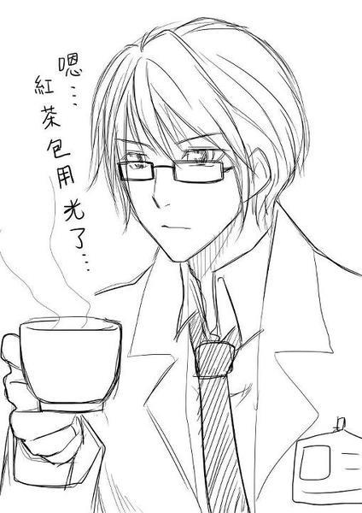
Thank you for your attention. ˊ_>ˋ

